Slide 1


<Name>
<Date>

Slide 2

Outline
Executive Summary
Introduction
Methodology
Results
Conclusion
Appendix

Slide 3
Executive Summary
The process of prediction of Spacex Falcon9 land went through data collection, data wrangling, visualization and Machine learning algorithms.
The SpaceX is gradually succeeding in its mission. The success of mission is dependent on booster versions, payload mass, launch site and some other factors which will be touched upon on in the presentation.

Slide 4
Introduction
In this final project, successful landing of Falcon 9 first stage will be evaluated. SpaceX advertises Falcon 9 rocket launches on its website with a cost of 62 million dollars; other providers cost upward of 165 million dollars each, much of the savings is because SpaceX can reuse the first stage. Therefore if we can determine if the first stage will land, we can determine the cost of a launch. This information can be used if an alternate company wants to bid against SpaceX for a rocket launch.
Various factors affecting the landing should be evaluated such as payload mass, launch sites, orbits in order to determine the successful landing. Machine learning algorithms needs to be developed for this task.

Slide 5

Section 1

Slide 6
Methodology
Executive Summary
Data collection methodology:
Data is gathered from SpaceX REST API and Wikipedia Pages through Web Scraping
Perform data wrangling
Wrangling data using an API, sampling data and dealing with Null values
Perform exploratory data analysis (EDA) using visualization and SQL
Perform interactive visual analytics using Folium and Plotly Dash
Perform predictive analysis using classification models
The machine learning model will use public information to determine if SpaceX reuse first stage

Slide 7
Data Collection
Data which are public information gathered from different sources:
SpaceX REST API: The API shares information about launches, payload, landing specification and outcomes.
Web scraping of Wikipedia pages which has data about Falcon 9 launch data

Slide 8
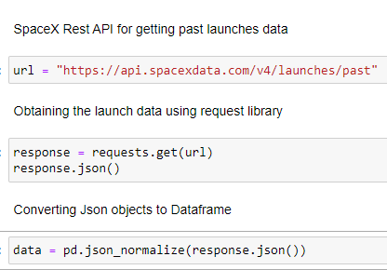
Data Collection – SpaceX API
Data collection with SpaceX REST
https://github.com/SuhrabAria/IBM-Applied-Data-Science-Capstone/blob/main/jupyter-labs-spacex-data-collection-api.ipynb

Slide 9
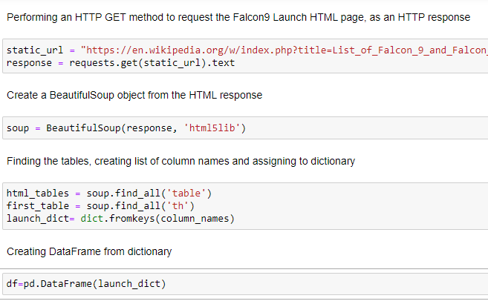
Data Collection - Scraping
Web scraping process
https://github.com/SuhrabAria/IBM-Applied-Data-Science-Capstone/blob/main/jupyter-labs-webscraping.ipynb

Slide 10
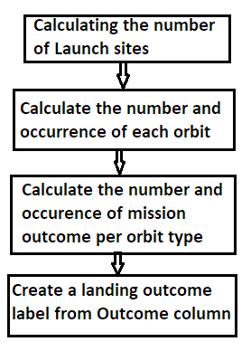
Data Wrangling
Data wrangling process
https://github.com/SuhrabAria/IBM-Applied-Data-Science-Capstone/blob/main/labs-jupyter-spacex-Data%20wrangling.ipynb

Slide 11
EDA with Data Visualization
Scatter point charts, bar plot and line chart plotted in order to see the following results:
Relationship between landing and payload mass
Relationship between landing and launch sites
Relationship between launch sites and payload mass
Relationship between success rate and orbit types
Relationship between Payload and Orbit type
To get the success rate by year
https://github.com/SuhrabAria/IBM-Applied-Data-Science-Capstone/blob/main/jupyter-labs-eda-dataviz.ipynb

Slide 12
EDA with SQL
The following SQL queries performed on dataset:
Found the maximum and average payload carried by boosters
Found successful landing outcome on ground pad and drone ship
Found the number of both successful and failed landings
Found the landing outcomes within specific time intervals
https://github.com/SuhrabAria/IBM-Applied-Data-Science-Capstone/blob/main/jupyter-labs-eda-sql-coursera.ipynb

Slide 13
Build an Interactive Map with Folium
For better understanding and visualization of the launch sites, markers, circles and lines created using folium for the following purposes:
Marking all launch sites on a map
Marking both successful and failed launches for a site
Measure the distance between launch sites
https://github.com/SuhrabAria/IBM-Applied-Data-Science-Capstone/blob/main/lab_jupyter_launch_site_location.ipynb

Slide 14
Build a Dashboard with Plotly Dash
The Dashboard has a pie chart and scatter point chart along with dropdown list and range slider to interact with them.
The plots and interactions added:
To find out the largest successful launches
To find out the highest launch success rate
To find out payload range(s) has the highest launch success rate
https://github.com/SuhrabAria/IBM-Applied-Data-Science-Capstone/blob/main/SpaceX_lanuch_records_dashboard.ipynb

Slide 15
Predictive Analysis (Classification)
The data transformed and split into training and testing.
Different machine learning models were built and tune different hyperparameters using GridSearchCV.
Accuracy as the metric for our model used, improved the model using feature engineering and algorithm tuning.
Finally, the best performing classification model.
https://github.com/SuhrabAria/IBM-Applied-Data-Science-Capstone/blob/main/SpaceX_Machine%20Learning%20Prediction_Part_5%20(1).ipynb

Slide 16
Results
Exploratory data analysis results
Interactive analytics demo in screenshots
Predictive analysis results

Slide 17

Section 2

Slide 18
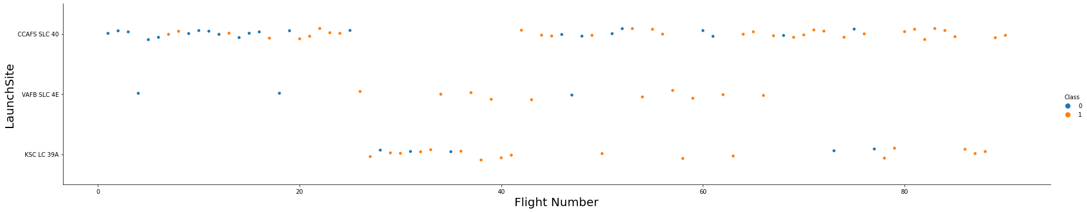
Flight Number vs. Launch Site

Slide 19
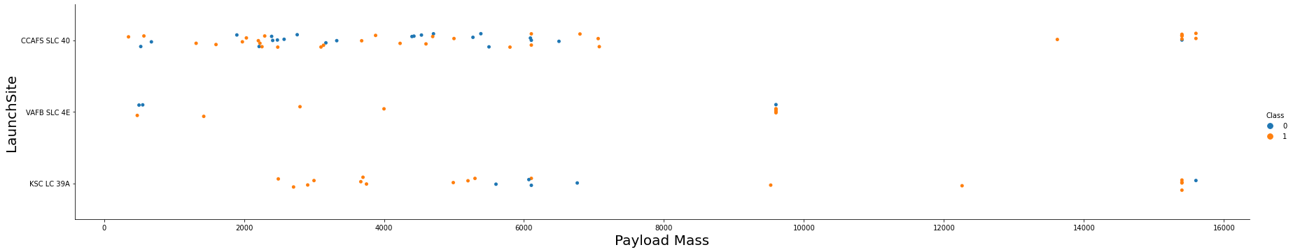
Payload vs. Launch Site
The chart shows for the VAFB-SLC launchsite there are no rockets launched for heavypayload mass(greater than 10000)

Slide 20
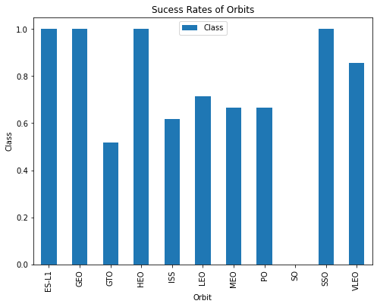
Success Rate vs. Orbit Type
The bar chart shows that ES-L1, GEO, HEO and VLEO orbits have highest sucess rate.

Slide 21
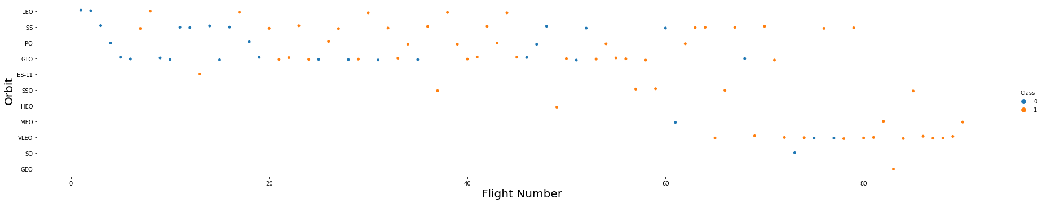
Flight Number vs. Orbit Type
The scatter point shows that in the LEO orbit the Success appears related to the number of flights; on the other hand, there seems to be no relationship between flight number when in GTO orbit.

Slide 22
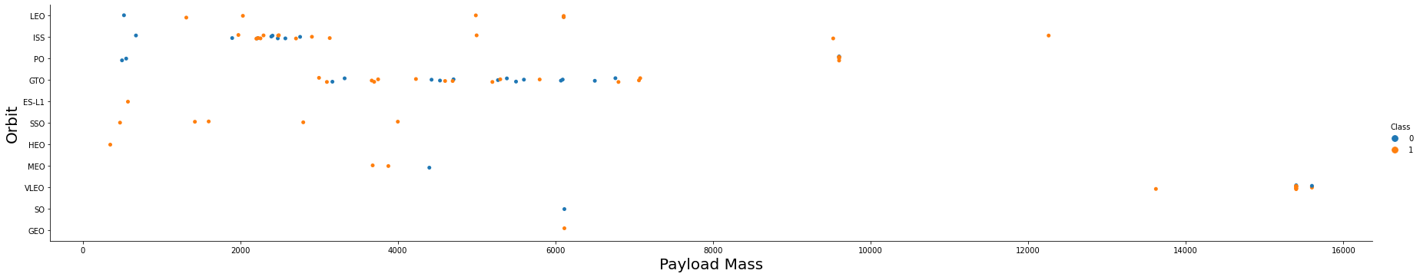
Payload vs. Orbit Type
With heavy payloads the successful landing or positive landing rate are more for Polar, LEO and ISS, but for GTO it is the opposite.

Slide 23
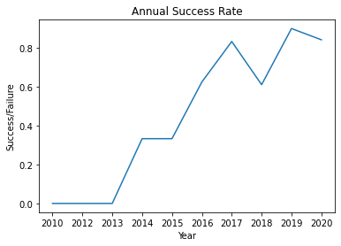
Launch Success Yearly Trend
The success rate since 2013 kept increasing till 2020

Slide 24
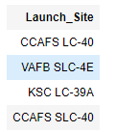
All Launch Site Names
There have been four unique launch sites

Slide 25
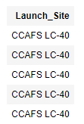
Launch Site Names Begin with 'CCA'
Five records where launch sites begin with `CCA`

Slide 26
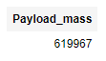
Total Payload Mass
The Total payload carried by boosters from NASA is 619967 Kilogram.

Slide 27
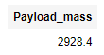
Average Payload Mass by F9 v1.1
The average payload mass carried by booster version F9 v1.1 was 2928.4 Kilogram.

Slide 28
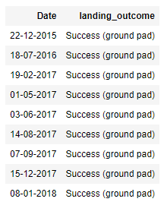
First Successful Ground Landing Date
End of 2015 marked with first successful
landing outcome on ground pad.

Slide 29
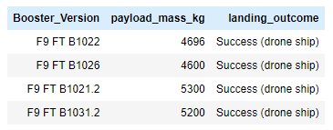
Successful Drone Ship Landing with Payload between 4000 and 6000
There had been four boosters which have successfully landed on drone ship and had payload mass greater than 4000 but less than 6000

Slide 30
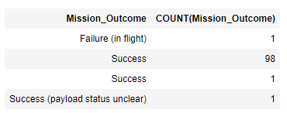
Total Number of Successful and Failure Mission Outcomes
There have been a total number of 101 successful and failure mission

Slide 31
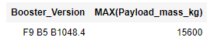
Boosters Carried Maximum Payload
Booster F9 v1.0 B0003 carried the maximum payload mass as shown below

Slide 32
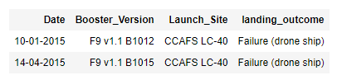
2015 Launch Records
The following query result shows list of failed landing outcomes in drone ship, their booster versions, and launch site names for in year 2015

Slide 33
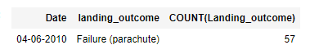
Rank Landing Outcomes Between 2010-06-04 and 2017-03-20
The following result shows landing outcomes (such as Failure (drone ship) or Success (ground pad)) between the date 2010-06-04 and 2017-03-20, in descending order

Slide 34

Section 3

Slide 35

Launch Sites
The following map shows the launch sites.

Slide 36
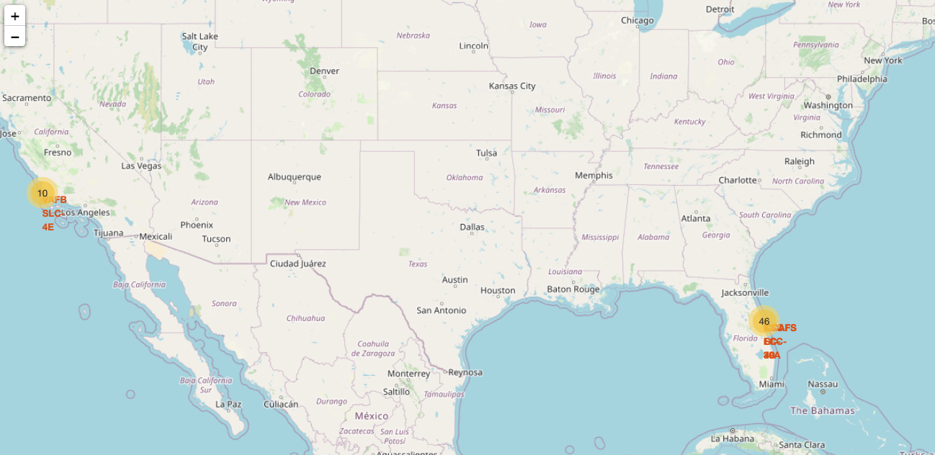
Launch Sites with High Success Rate
The following map shows launch sites which have relatively high success rates

Slide 37

Launch Site Proximities
The following map shows a launch site distance with costal area and a highway closer than coast

Slide 38

Section 4

Slide 39
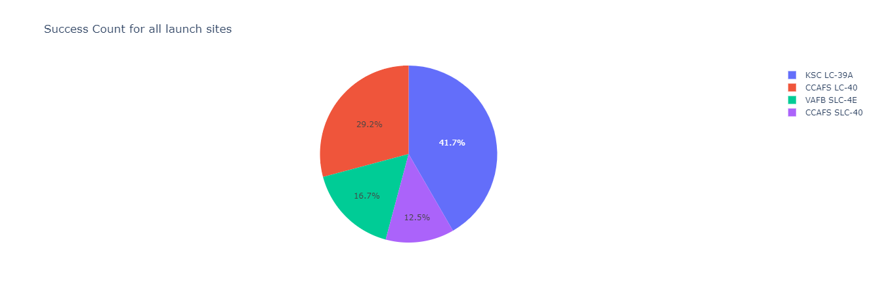
Success Rates of All Launch sites
The pie chart shows the success rates of all launch sites.

Slide 40
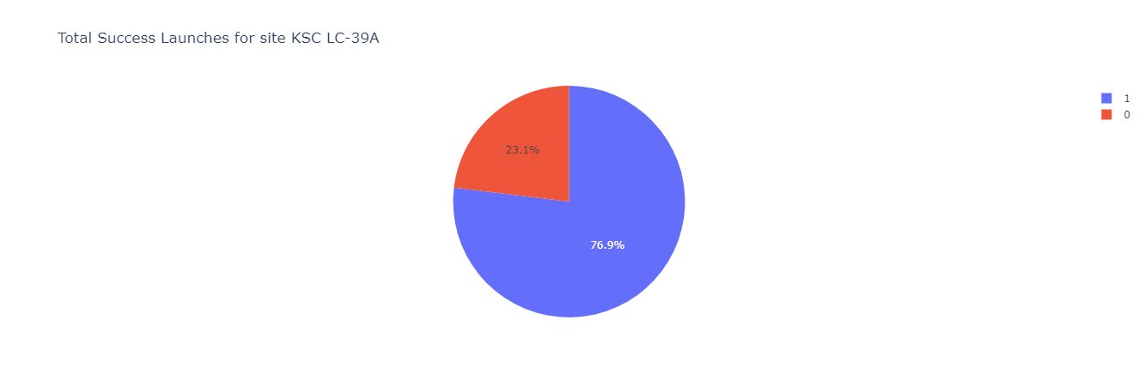
Highest Success Ration
As shown below KSC LC-39A launch sites highest success ratio.

Slide 41
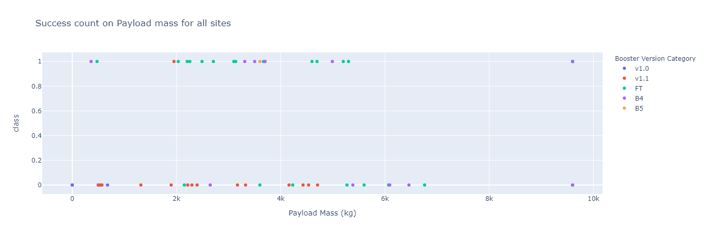
Success Count on Payload mass for all sites
Booster version FT has the largest success rate according to below scatter point

Slide 42

Section 5

Slide 43
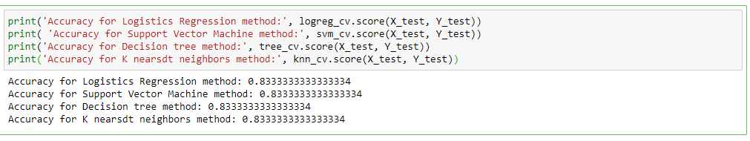
Classification Accuracy
The accuracy of all algorithms generate the same result as shown below

Slide 44
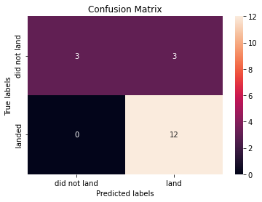
Confusion Matrix
Since Logistic Regression, SVM, K nearest Neighbor and decision tree has the same accuracy, it is concluded that all mentioned models perform well.

Slide 45
Conclusions
The launch success rate shows an upward trend from 2013 onward. It is worth mentioning that number of launches has also increased.
From launch sites, KSC LC-39A has the highest success rate which was 41.7 percent.
Considering the payload mass, BT and F4 booster versions had highest success rates.
Logistic Regression, SVM, K nearest Neighbor and decision tree are best model to predict the success as their accuracy was the same.

Slide 46


